Slide 1
STUDENT PERFORMANCE ANALYSIS

Slide 2
INTRODUCTION
Educational institutions need to understand the factors associated with student academic performance in order to identify areas where students may benefit from additional support. However, analysing multiple factors such as study behaviour, attendance, academic support, motivation, lifestyle, access to resources, and social engagement can be challenging without a clear data-driven approach.
This project uses Power BI to analyse student performance data and explore patterns and relationships between these factors and Exam Score. The analysis aims to understand what factors are associated with academic performance, identify students showing multiple indicators for further academic review, and provide data-driven insights that can help educators make informed decisions about academic support and student engagement.

Slide 3
PROBLEM STATEMENT
Schools need to understand the factors that may influence students' academic performance so they can provide appropriate academic support and allocate resources effectively. However, student information such as attendance, study hours, parental involvement, access to resources, motivation, tutoring, sleep, and previous academic performance is often analysed separately. This project uses student academic data in Power BI to examine the relationship between student characteristics, learning behaviours, social factors, and educational support and students' final exam scores. The analysis will help identify patterns associated with higher or lower academic performance and provide data-driven recommendations that schools can use to improve student outcomes.

Slide 4
DATA QUALITY
Duplicate records: Duplicated rows were checked and removed to prevent repeated records from affecting the analysis
Missing values: All columns were checked for blank or missing values. No missing values were identified, therefore no replacement was needed
Categorical consistency: such as Teacher Quality, Motivation level, Parental involvement, and access to resource were reviewed to ensure values were consistently labelled and categorised
Exam score anomaly: One Exam Score vaule of 101 was identified.. The Kaggle documentation defines this field as the student's final exam score but does not specify a maximum score. Therefore, the value was retained rather than assumed to be an error, and its potential impact on the analysis was considered.
Numerical validation: such as Hours studied, Attendance, Sleep Hours, Previous scores, Tutoring Sessions and Exam score were checked for appropriate data types and reasonable value ranges.
Derived categories and indicators: Additional groups were created to support the analysis, including Attendance group, Study hours flag, Exam score flag, and support indicator group.

Slide 5
DATASET

Slide 6
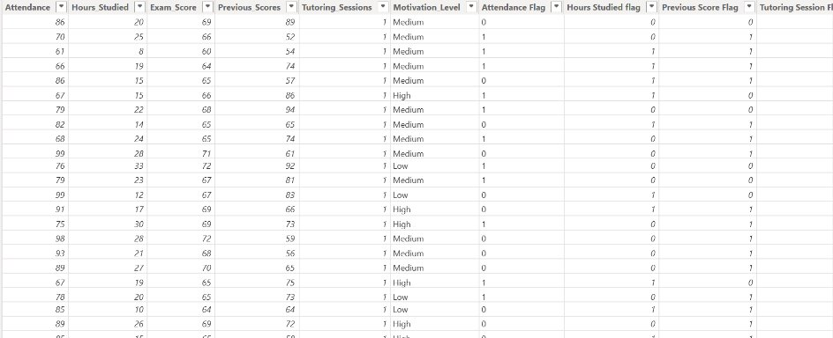

Slide 7
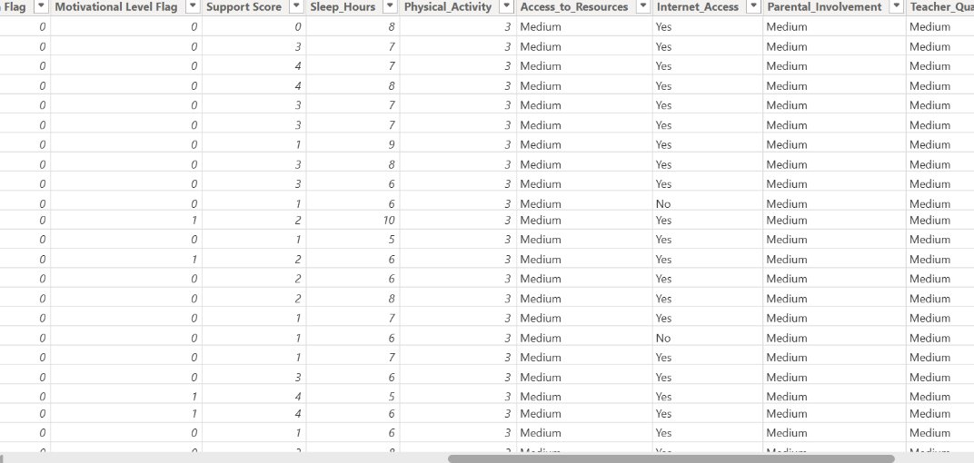

Slide 8
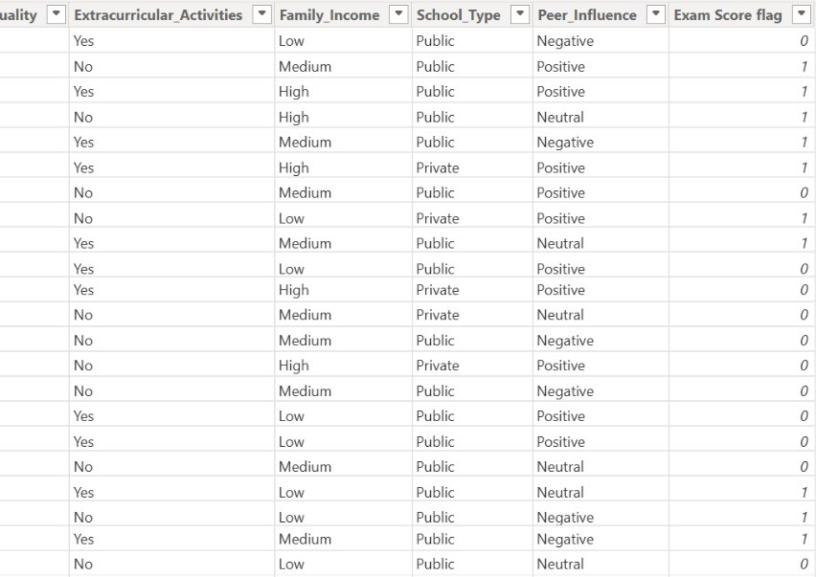

Slide 9
OBJECTIVES
Analyse study behaviour and academic performance
Examine the relationship between academic support and Exam Score
Analyse the impact of student motivation and lifestyle factors
Examine the influence of resources and learning environment
Analyse social and extracurricular factors
Identify students who may require additional academic support

Slide 10
STUDY BEHAVIOUR AND ACADEMIC PERFORMANCE
Students with higher study hours (40) recorded a higher average Exam Score of 37 and attendance of 79.66%, compared with students studying fewer hours (33), who recorded an average Exam Score of 19 and attendance of 71.85%. This suggests that stronger study engagement and attendance are associated with better academic performance. Schools should prioritise targeted study-support programmes for students showing lower study engagement, attendance and academic performance, while encouraging effective study habits among students.

Slide 11
RELATIONSHIP BETWEEN ACADEMIC SUPPORT AND EXAM SCORE
Students receiving higher academic support has high parental involvement, high teacher quality and attends 6 out of 8 tutoring sessions recorded a higher average Exam Score of 74%, compared with 67% among students experiencing lower teacher quality despite having the same parental involvement and tutoring participation.
However, the study-behaviour analysis (another graph ) indicates that extra support needed for this group is moderate, suggesting that strong study behaviour may reduce the need for additional external academic support. Business decision = The School should prioritise a combination of strong parental involvement, quality teaching and targeted tutoring, while also developing students' independent study skills. This can help schools focus additional support on students showing multiple academic-performance and engagement indicators.

Slide 12
IMPACT OF STUDENT MOTIVATION AND LIFESTYLE FACTORS
Students with higher motivation recorded a higher average exam score of 71.75%, compared with 70.50% among students with lower motivation, suggesting a positive association between motivation and academic performance. The School should consider combining academics with student engagement and wellbeing activities for example monthly student check-in on their health, physical activity programmes to improve motivation levels and willingness to learn.

Slide 13
INFLUENCE OF RESOURCES AND LEARNING ENVIRONMENT
Students with higher access to resources generally recorded higher average exam scores than those with lower access, regardless of school type. The highest average score was among public-school students with high resource access 68.15%, while the lowest was among private-school students with low resource access 66.31%. However, the differences between school types were small. Business Decision = The School should prioritise improving access to educational resources for students with lower resource access, while monitoring whether increased access is associated with improved academic performance, because the difference from my datatset is small to prove causation.

Slide 14
SOCIAL AND EXTRACURRICULAR FACTORS
Extracurricular participation was associated with slightly higher average exam scores across both positive and negative peer-influence groups. Among students with negative peer influence, those participating in extracurricular activities averaged 72.00 compared with 70.50 for non-participants. Among students with positive peer influence, participants averaged 70.67 compared with 69.80 for non-participants. Business decision = The School should continue to encourage balanced extracurricular participation while monitoring students' academic workload and peer environment.

Slide 15
STUDENTS WHO MAY REQUIRE ADDITIONAL ACADEMIC SUPPORT
A Support Score combining six academic and engagement indicators was developed to identify students showing multiple indicators for further review. The findings suggest that lower study engagement, motivation, academic performance and limited access to resources may be associated with greater support indicators, while strong study behaviour and participation in extracurricular activities may be associated with better engagement and performance. Business decision= Schools should use the Support Score to prioritise students showing multiple indicators for further review and provide targeted support through study-skills programmes, mentoring, tutoring, improved access to learning resources and structured extracurricular activities.

Slide 16
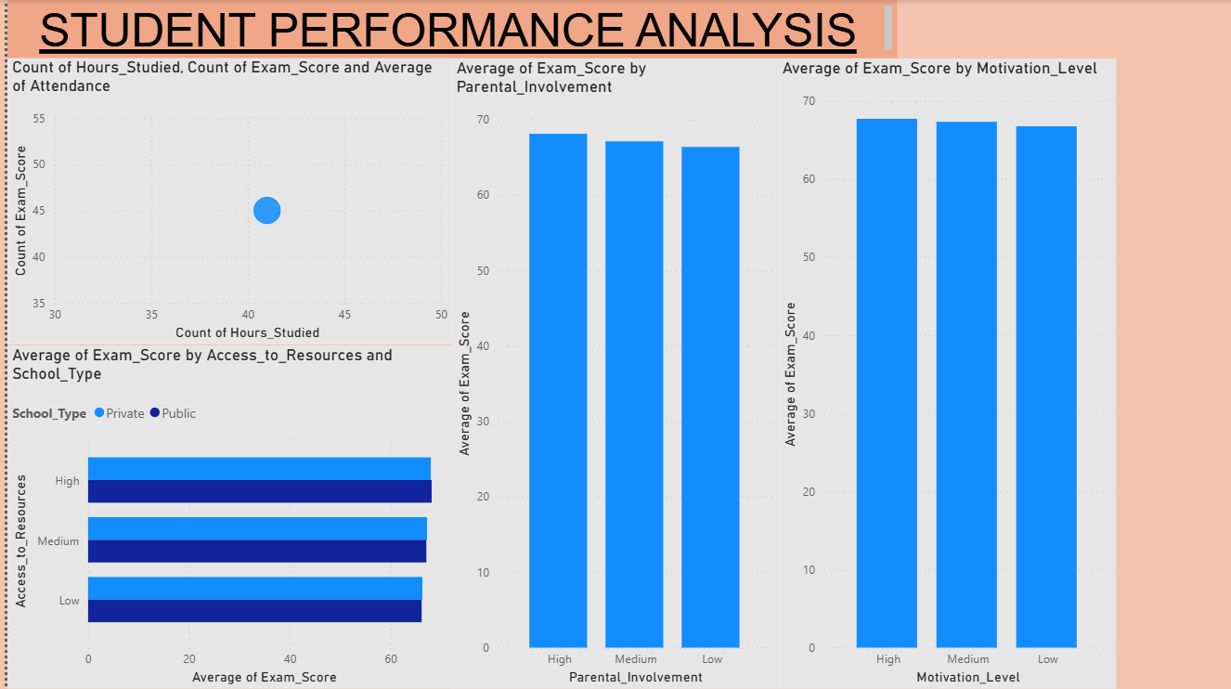
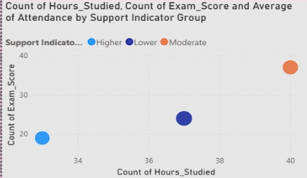

Slide 17
